Slide 1
Programming Languages -1
(Introduction to C) strings
Instructor: M.Fatih AMASYALI
E-mail:mfatih@ce.yildiz.edu.tr

Slide 2
The Data Type char
The data type char can be thought of as either a character or an integer. Typically, a char has a value 0-255.
printf( “%c”, ‘a’ ); /* a is printed */
printf( “%d”, ‘a’ ); /* 97 is printed */
printf( “%c”, 97 ); /* a is printed */
‘a’ == 97, ‘b’ == 98, …, ‘z’ == 112
‘A’ == 65, ‘B’ == 66, …, ‘Z’ = 90
‘0’ == 48, ‘1’ == 49, …, ’9’ == 57
‘&’ == 38, ‘*’ == 42, …

Slide 3
Codes corresponding to characters
For use inside in single-quotes, or double-quotes, for instance in passing a string to printf
Character Escape Sequence Integer Value
Newline \n 10
Backslash (\) \\ 92
Single quote \’ 39
Double quote \” 34
Horizontal tab \t 9
Question Mark \? 63
Null Character \0 0

Slide 4
Strings
Strings are one-dimensional arrays of type char. Hence, they have type char *.
By convention, a string in C is terminated by \0 (null character); thus it needs space equal to the size of string +1
A string constant is treated by the compiler as a pointer; also space in memory is allocated for storing the characters.
C | o | r | n | e | l | l |  | U | n | i | \0
0 | 1 | 2 | 3 | 4 | 5 | 6 | 7 | 8 | 9 | 10 | 11
char *p = “abc”;
printf(“%s %s\n”, p, p+1 ); /* prints abc bc */
printf(“%c”,"abc”[1]); /* prints b */
printf(“%c”,*(“abc” + 2)); /* prints c */

Slide 5
Example: “Double” printing
#include <stdio.h>
void new_print( char *s )
{
int i;
for( i = 0; s[i] != 0; i++ )
{
printf( "%c%c", s[i], s[i] );
}
}
void main()
{
new_print( “Cornell" );
}
All of {0 , ‘\0’, NULL} are legal.

Slide 6
Strings are also char pointers
#include <stdio.h>
void new_print( char *s )
{
while (*s)
{
printf( "%c%c", *s, *s );
s++;
}
}
void main()
{
new_print( “Cornell" );
}

Slide 7
Example: “squeeze” function
/* squeeze deletes all instances of c from s */
void squeeze( char s[], int c )
{
int i, j;
for( i = j = 0; s[i] != ‘\0’; i++ )
{
if( s[i] != c )
{
s[j] = s[i];
j++;
}
}
s[j] = ‘\0’;
}
Usage:
char p[]="Cornell";
squeeze( p, 'o');
printf("%s\n",p);

Slide 8
String Input/Output
#include <stdio.h>
#define MAXLENGTH 15
int main()
{
char string1[MAXLENGTH];
char string2[MAXLENGTH];
scanf("%s %s", string1, string2);
printf("%s %s\n", string1, string2);
return 0;
}

Slide 9
Character String Declaration
Declaration 1:
char name[5] = “Ann”;
name
is 0x2000
A
n
n
\0
0x2000
0x2004

Slide 10
Character String Declaration
Declaration 1:
char name[5] = “Ann”;
Could have defined this as an array:
name
is 0x2000
char name[5] = {’A’,’n’,’n’,’\0’};
A
n
n
\0
0x2000
0x2004

Slide 11
Character String Declaration (cont)
Can store
at most 4 letters,
because of `\0’
Declaration 1:
char name[5] = “Ann”;
name
is 0x2000
A
n
n
\0
0x2000
0x2004

Slide 12

Character String Declaration (cont)
Takes up an
extra cell for ‘\0’
Declaration 2:
char name[] = “Ann”;
name
is 0x2000
A
n
n
\0
0x2000
0x2003

Slide 13
Character String Declaration (cont)
Declaration 3:
Result is “undefined”
if you try to modify
this string
char *name = “Ann”;
0x3000
A
n
n
\0
name
0x3000
0x3003

Slide 14

Character String Declaration (cont)
Declaration 4:
char name[];
String with arbitrary length?
No! Will cause an error
“storage size of k isn’t known”

Slide 15
A Char in a String (cont)
0x3995
0x399C
name
is 0x3995
J
o
h
X
n
\0
index 2
char name[8] = “John”;
name[2] = ‘X’;
printf(“Name: %s\n”, name);

Slide 16
A Char in a String (cont)
0x3995
0x399C
name
is 0x3995
J
o
X
n
\0
index 2
char name[8] = “John”;
name[2] = ‘X’;
printf(“Name: %s\n”, name);
output: Name: JoXn

Slide 17

Common Mistake 1:
Example:
char name1[5] = “Anne”;
char name2[5] = “Dave”;
name2 = name1;
Error: “ISO C++ forbids assingment of arrays”

Slide 18
Caution 1:
Pointer Assignment
Example:
char *name1 = “Ann”;
char *name2 = “Dave”;
name2 = name1;

Slide 19
Caution 1:
Pointer Assignment
char *name1 = “Ann”;
char *name2 = “Dave”;
0x2000
A
n
n
\0
name1
0x2000
0x2003
0x3990
D
a
v
e
\0
name2
0x3990
0x3994

Slide 20
Caution 1:
Pointer Assignment
name2 = name1;
0x2000
A
n
n
\0
name1
0x2000
0x2003
0x2000
D
a
v
e
\0
name2
0x3990
0x3994

Slide 21
#include <stdio.h>
#include <string.h>
#define NAMELEN 50
/* Print a simple greeting to the user */
void Greet ( char * name )
{
strcat(name, "! How are ya?");
}
int main()
{
char user[NAMELEN];
printf("Who are you? ");
scanf("%s", user);
Greet(user);
printf("%s\n", user);
return 0;
}
user
Jake\0

Slide 22
#include <stdio.h>
#include <string.h>
#define NAMELEN 50
/* Print a simple greeting to the user */
void Greet ( char * name )
{
strcat(name, "! How are ya?");
}
int main()
{
char user[NAMELEN];
printf("Who are you? ");
scanf("%s", user);
Greet(user);
printf("%s\n", user);
return 0;
}
name
user
Jake\0

Slide 23
#include <stdio.h>
#include <string.h>
#define NAMELEN 50
/* Print a simple greeting to the user */
void Greet ( char * name )
{
strcat(name, "! How are ya?");
}
int main()
{
char user[NAMELEN];
printf("Who are you? ");
scanf("%s", user);
Greet(user);
printf("%s\n", user);
return 0;
}
name
user
Jake! How are ya?\0

Slide 24
#include <stdio.h>
#include <string.h>
#define NAMELEN 50
/* Print a simple greeting to the user */
void Greet ( char * name )
{
strcat(name, "! How are ya?");
}
int main()
{
char user[NAMELEN];
printf("Who are you? ");
scanf("%s", user);
Greet(user);
printf("%s\n", user);
return 0;
}
user
Jake! How are ya?\0

Slide 25
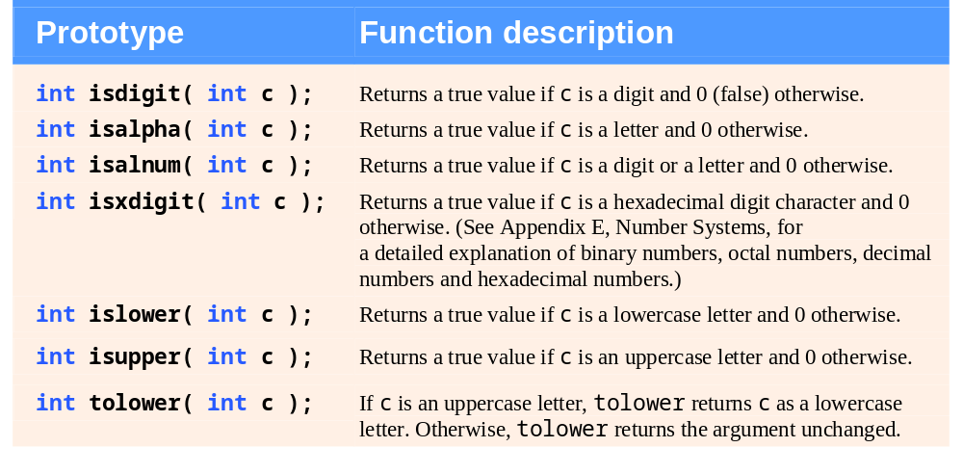
Character-handling library functions <ctype.h>.

Slide 26
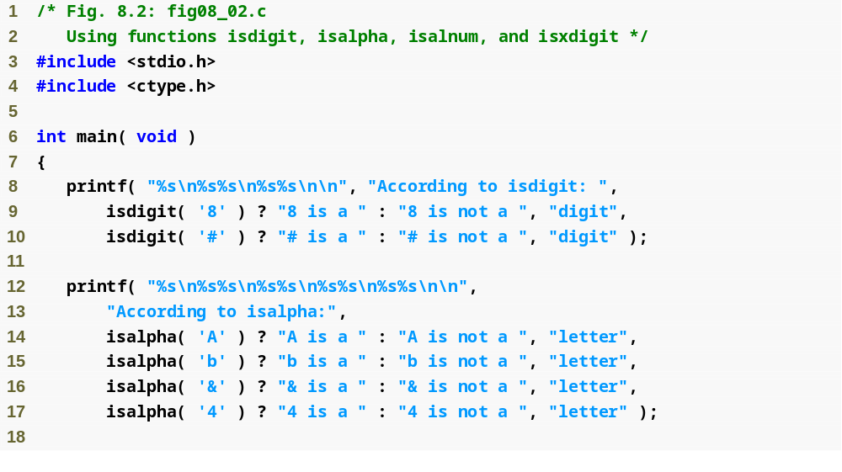
isdigit tests if a character is a decimal digit
isalpha tests if a character is a letter

Slide 27
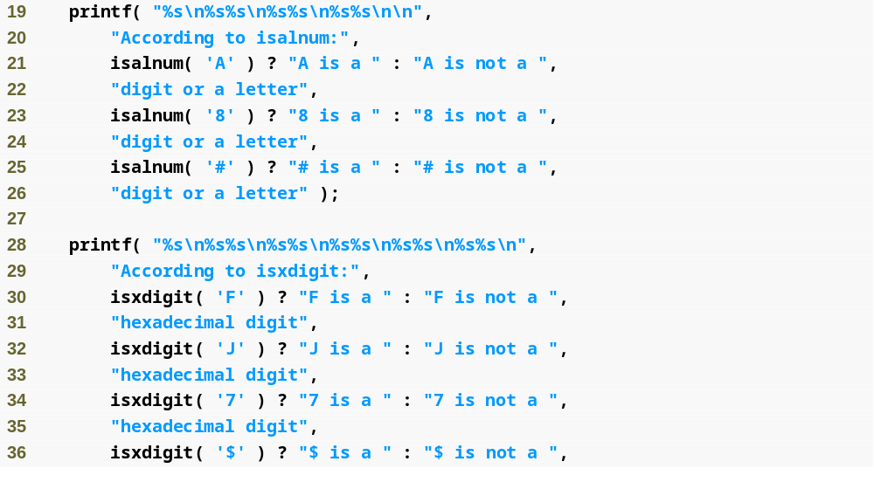
isdigit tests if a character is a decimal digit or a letter
isxdigit tests if a character is a hexadecimal digit

Slide 28
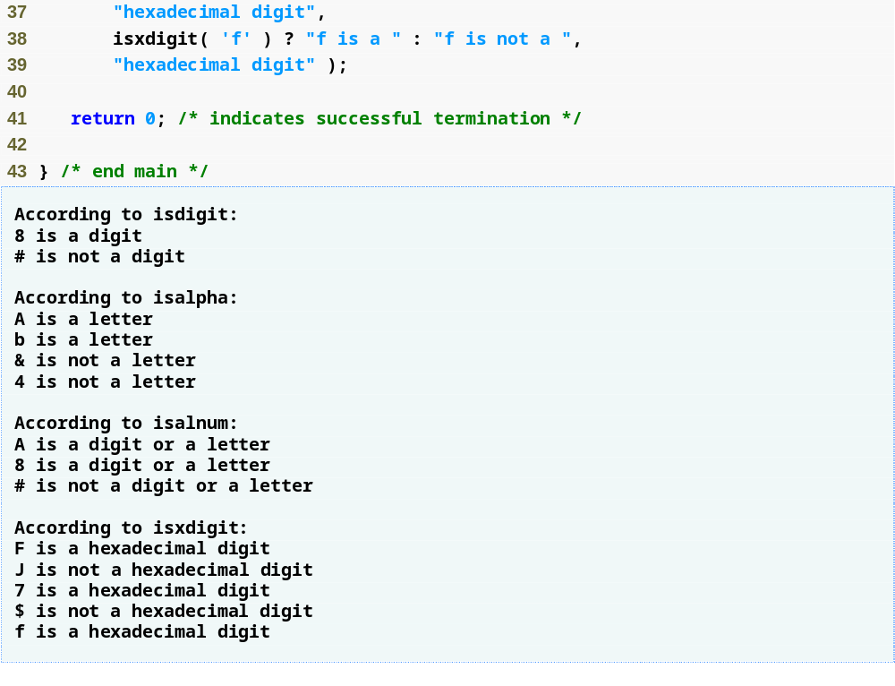

Slide 29
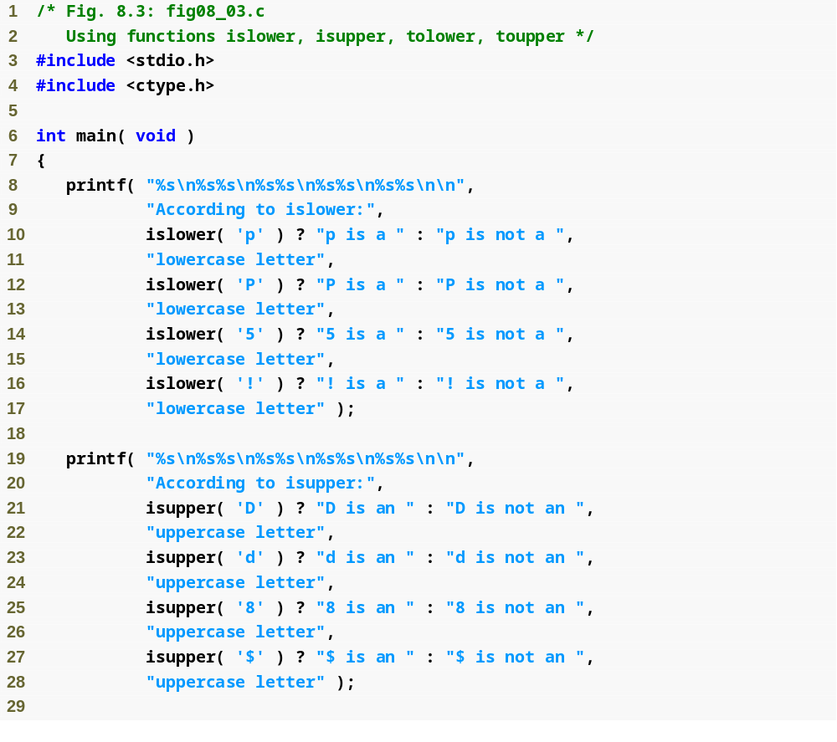
islower tests if a character is a lowercase letter
isupper tests if a character is an uppercase letter

Slide 30
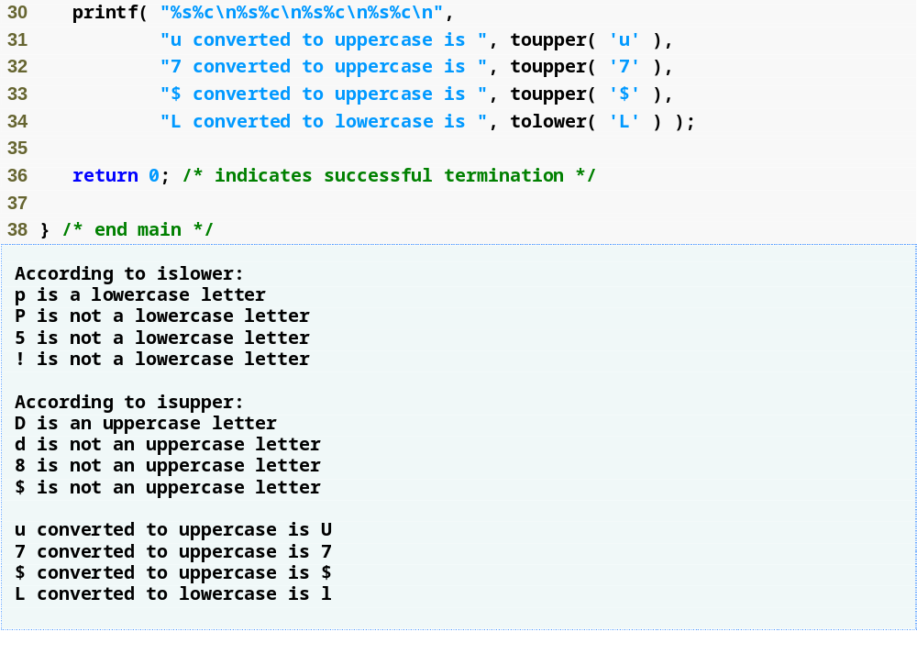
toupper and tolower convert letters to upper or lower case

Slide 31
String-Conversion Functions
Conversion functions
  In <stdlib.h> (general utilities library)
Convert strings of digits to integer and floating-point values

Slide 32
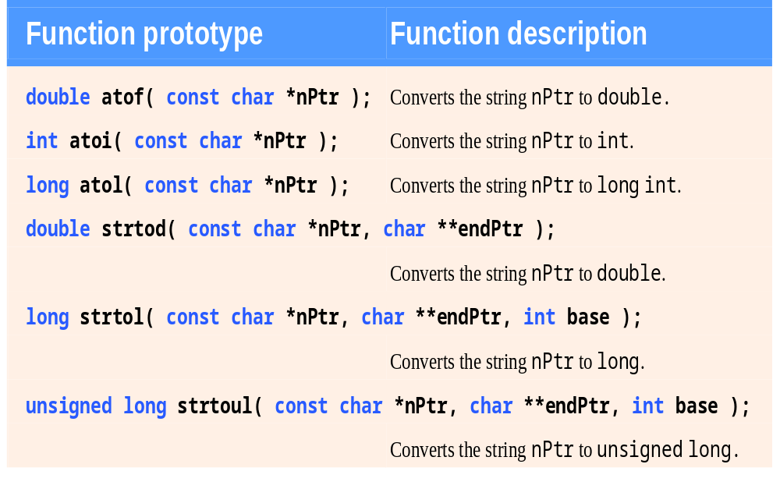
String-conversion functions of the general utilities library <stdlib.h> .

Slide 33
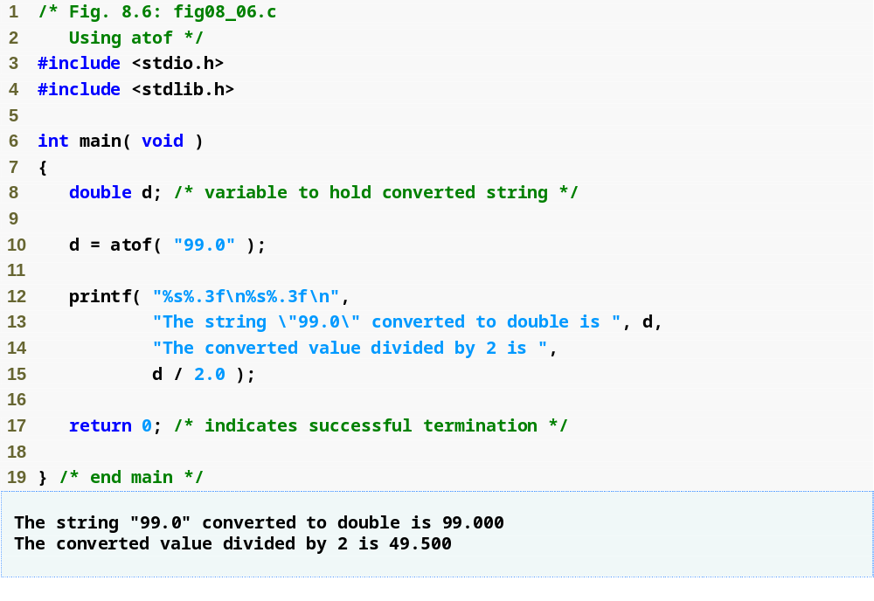
atof converts a string to a double

Slide 34
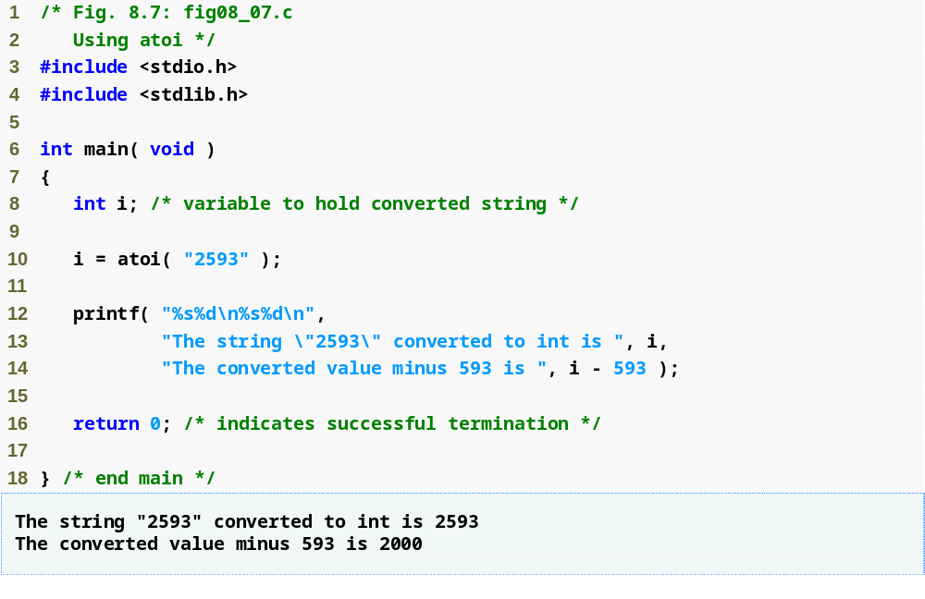
atoi converts a string to an int

Slide 35
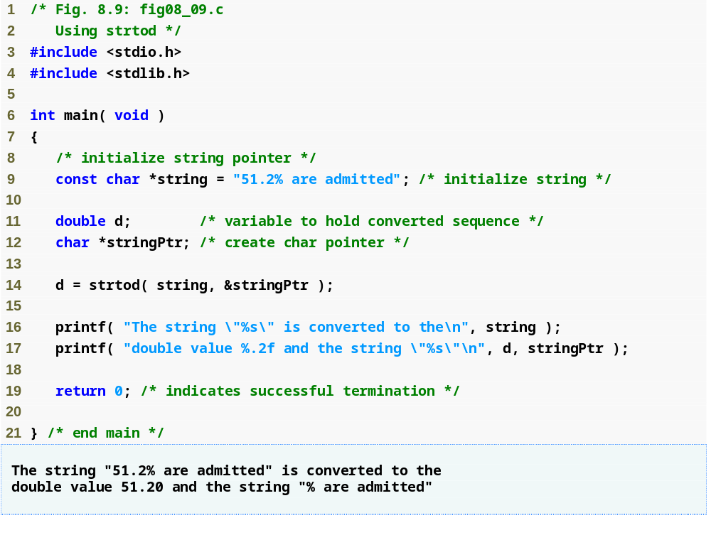
strtod converts a piece of a string to a double

Slide 36
Standard Input/Output Library Functions
Functions in <stdio.h>
Used to manipulate character and string data

Slide 37
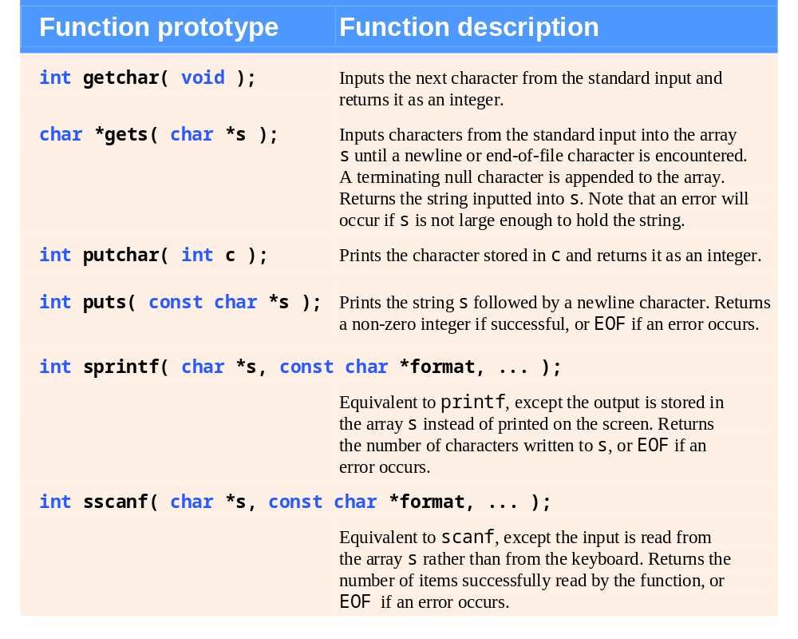
Standard input/output library character and string functions.

Slide 38
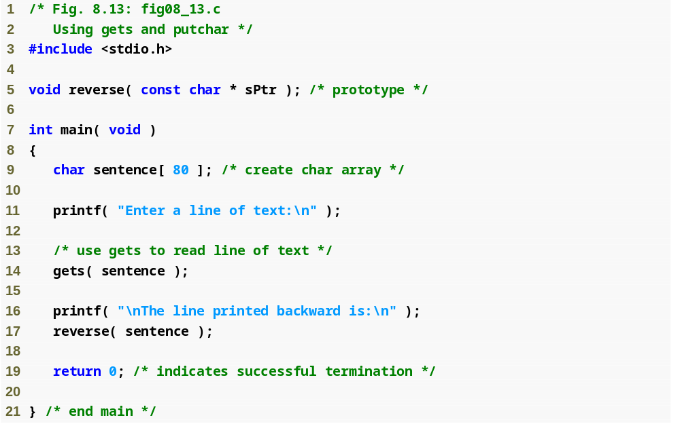
gets reads a line of text from the user

Slide 39
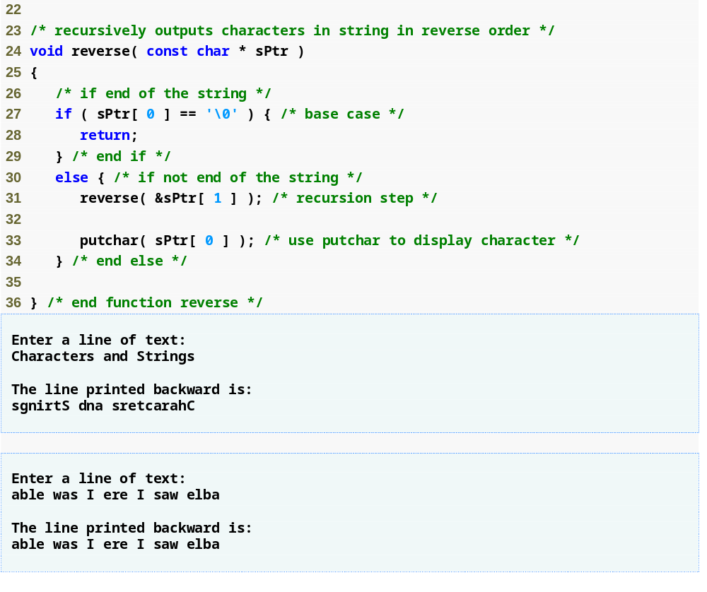
putchar prints a single character on the screen

Slide 40
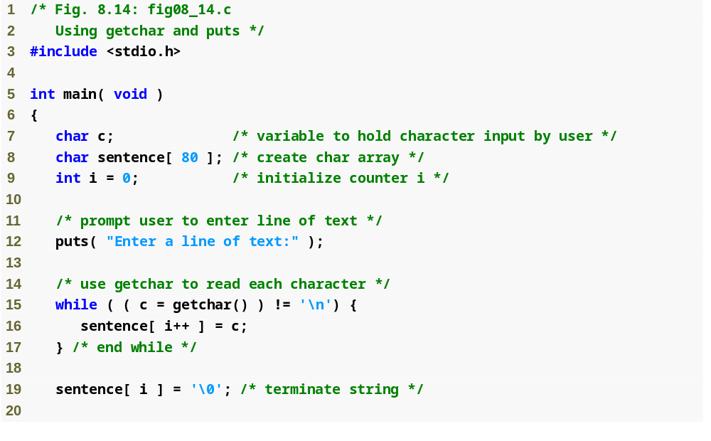
puts prints a line of text on the screen
getchar reads a single character from the user

Slide 41
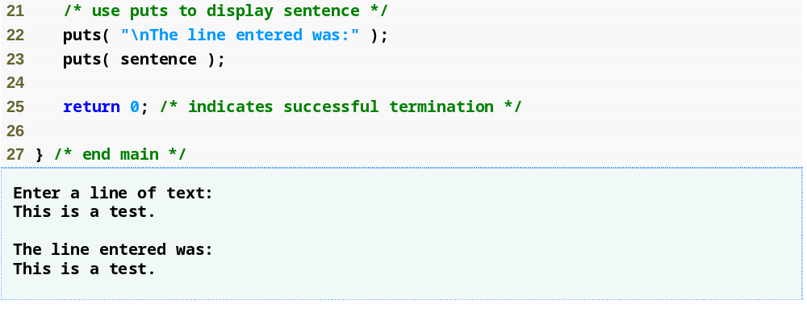

Slide 42
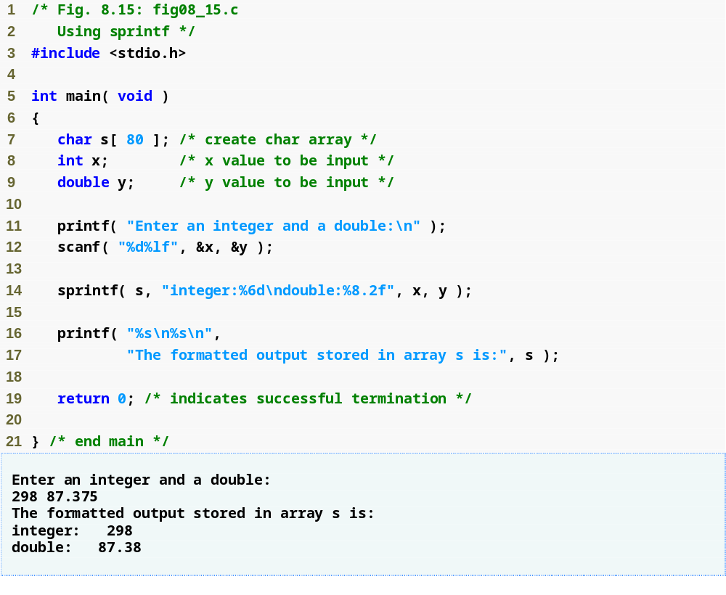
sprintf prints a line of text into an array like printf prints text on the screen

Slide 43
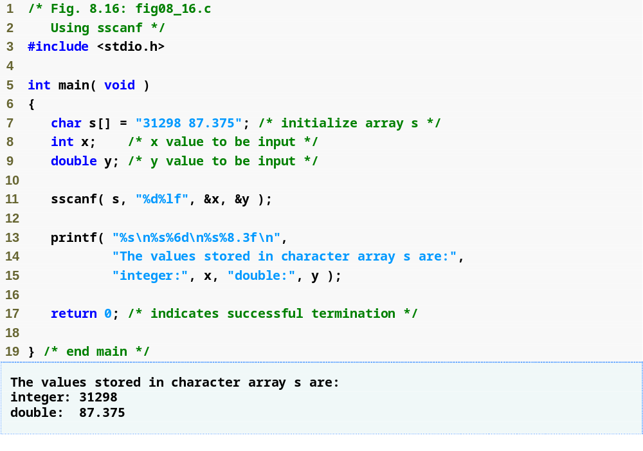
sscanf reads a line of text from an array like scanf reads text from the user

Slide 44
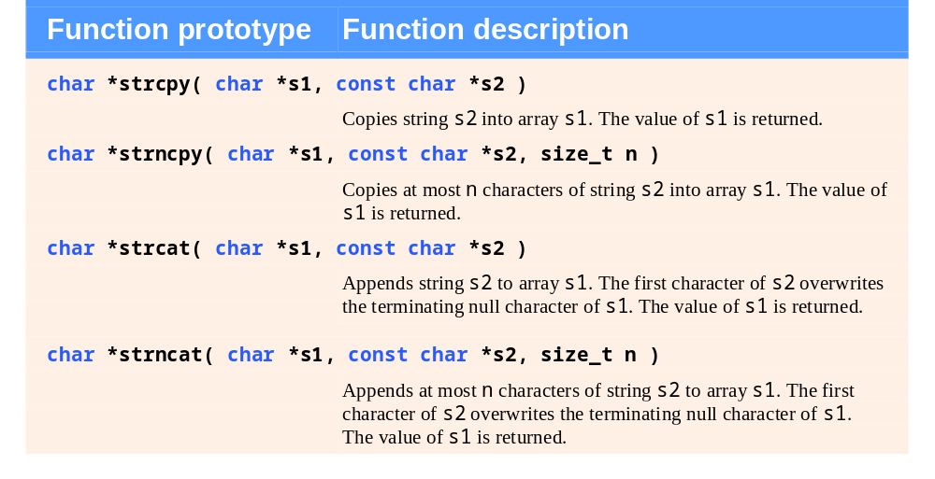
String-manipulation functions of the string-handling library.

Slide 45
Portability Tip
Type size_t is a system-dependent
synonym for either type unsigned
long or type unsigned int.

Slide 46
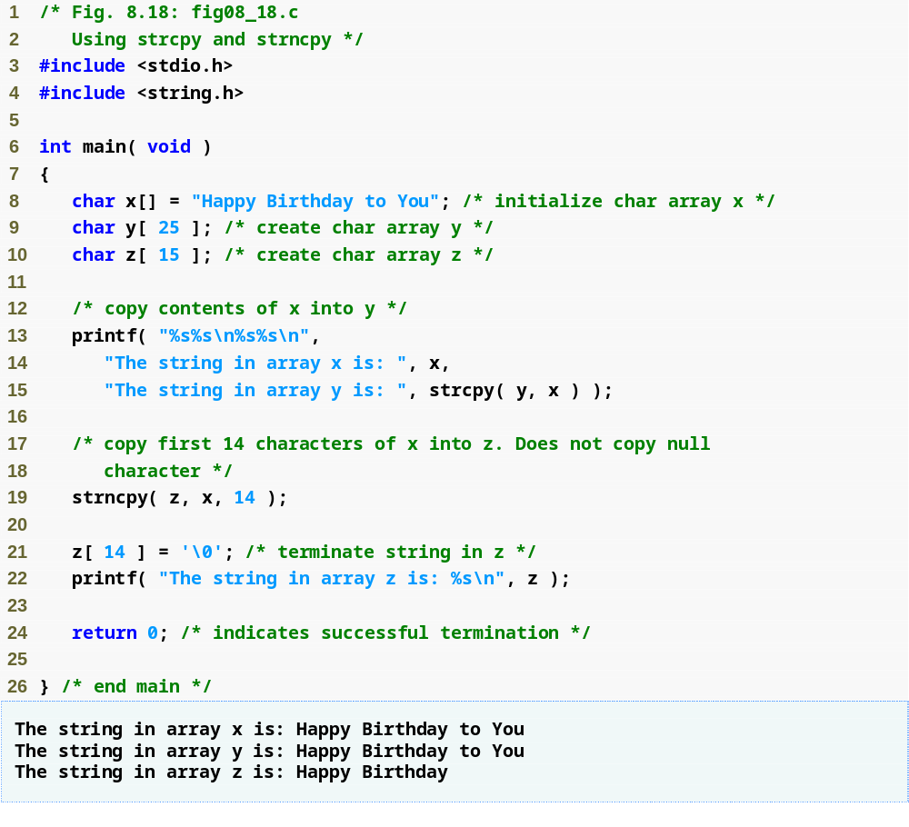
strcpy copies string x into character array y
strncpy copies 14 characters of string x into character array z
Note that strncpy does not automatically append a null character

Slide 47
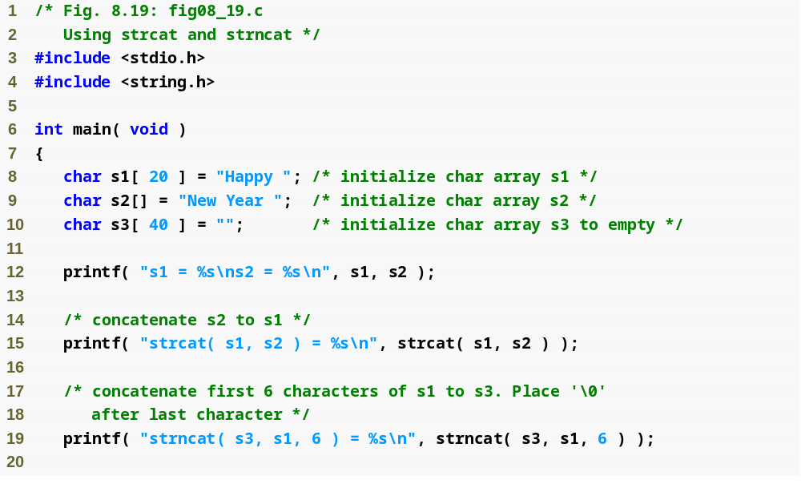
strcat adds the characters of string s2 to the end of string s1
strncat adds the first 6 characters of string s1 to the end of string s3

Slide 48
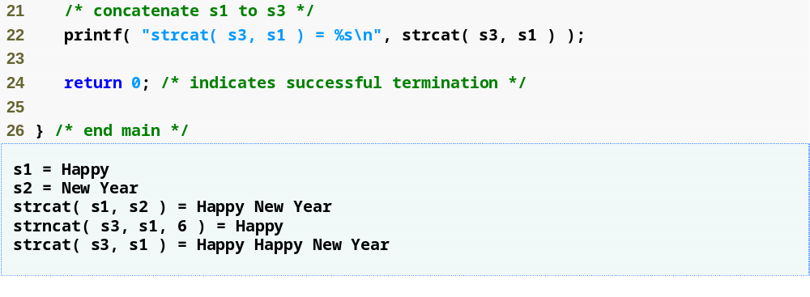

Slide 49
Comparison Functions of the String-Handling Library
Comparing strings
  Computer compares numeric ASCII codes of characters in string

Slide 50
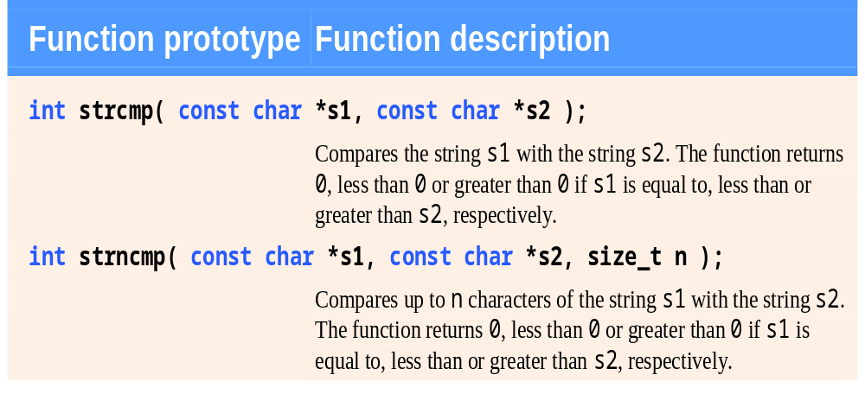
String-comparison functions of the string-handling library.

Slide 51
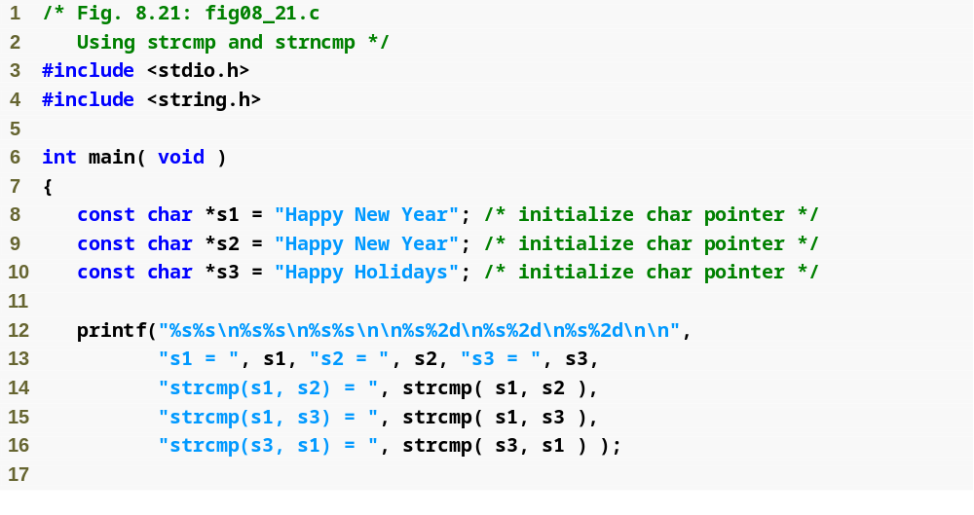
strcmp compares string s1 to string s2

Slide 52
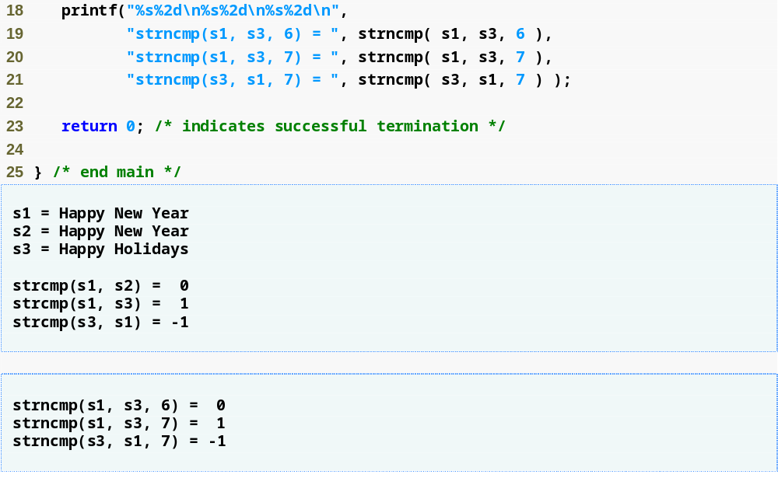
strncmp compares the first 6 characters of string s1 to the first X characters of string s3

Slide 53
Common Mistake:
Wrong Comparison
strcpy(string1, “Apple”);
strcpy(string2, “Wax”);
if (string1 < string2)
{
printf(“%s %s\n”, string1, string2);
}
else
{
printf(“%s %s\n”, string2, string1);
}

Slide 54
Caution 1:
strcpy(string1, “Hi Mum”);
strcpy(string2, “Hi Mum”);
if ( strcmp(string1, string2) )
{
printf(“%s and %s are the same\n”,
string1, string2);
}
Returns zero if the strings are the same.
if ( strcmp(string1, string2) == 0)

Slide 55
String Operation: Length
char string1[100];
strcpy(string1, “Apple”);
printf(“%d\n”, strlen(string1));
output: 5
Number of char-s
before the `\0’

Slide 56
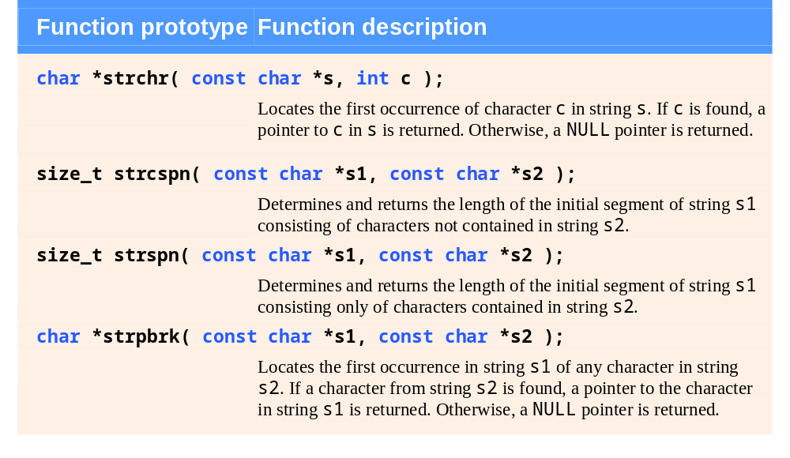
String-manipulation functions of the string-handling library.

Slide 57
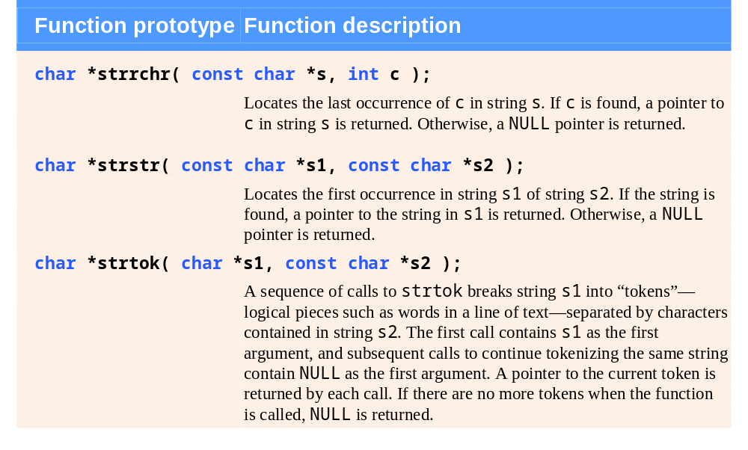
String-manipulation functions of the string-handling library.

Slide 58
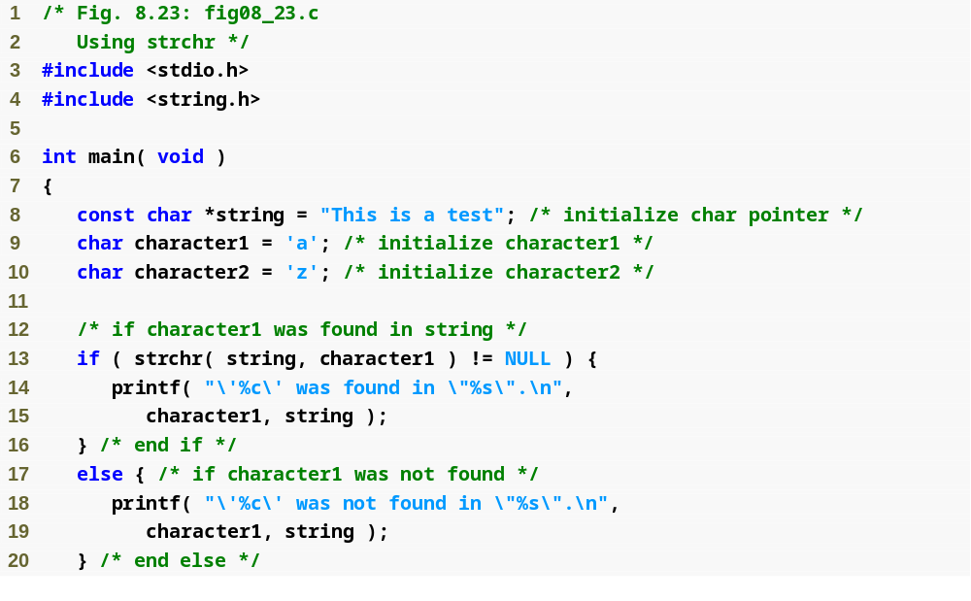
strchr searches for the first instance of character1 in string

Slide 59
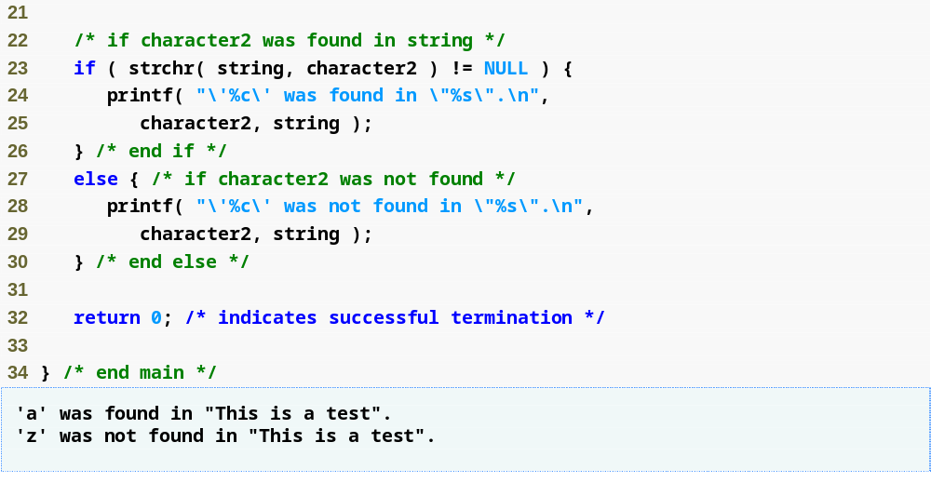

Slide 60
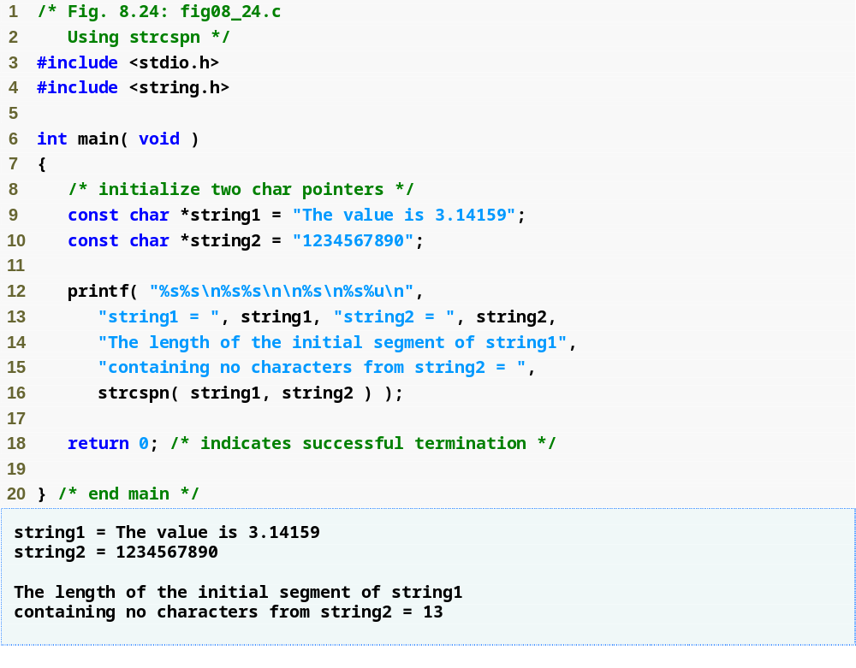
strcspn returns the length of the initial segment of string1 that does not contain any characters in string2
String1’in,
String2’deki karakterlerden
hiçbirini içermeyen,
ilk kısmının uzunluğu

Slide 61
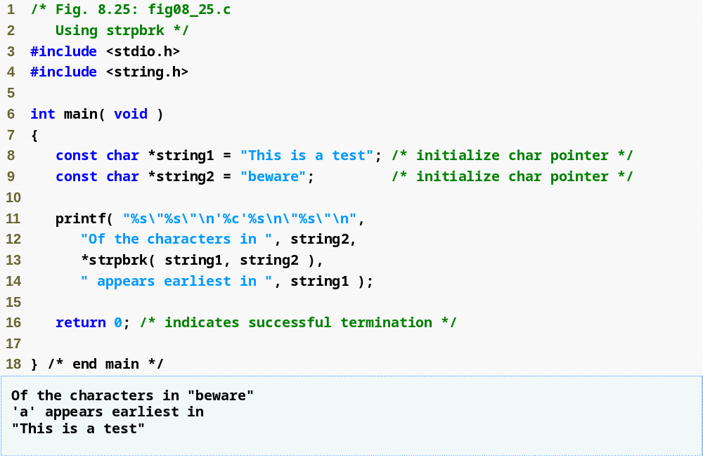
strpbrk returns a pointer to the first appearance in string1 of any character from string2
String1’de,
String2’deki karakterlerden
herhangi birinin ilk geçtiği yerin
adresi

Slide 62
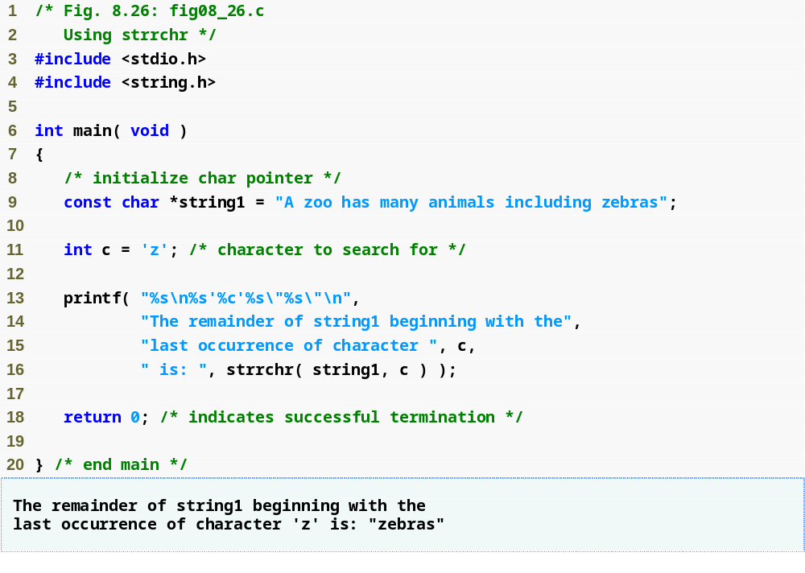
strrchr returns the remainder of string1 following the last occurrence of the character c
String1’in, c karakterinin son geçtiği
yerden itibarenki kısmı

Slide 63
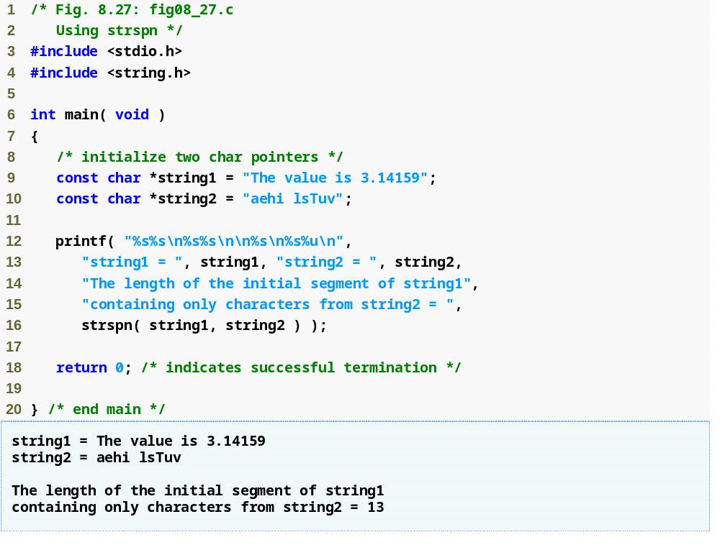
strspn returns the length of the initial segment of string1 that contains only characters from string2
String1’in,
Sadece String2’deki karakterlerden
oluşan ilk kısmının uzunluğu

Slide 64
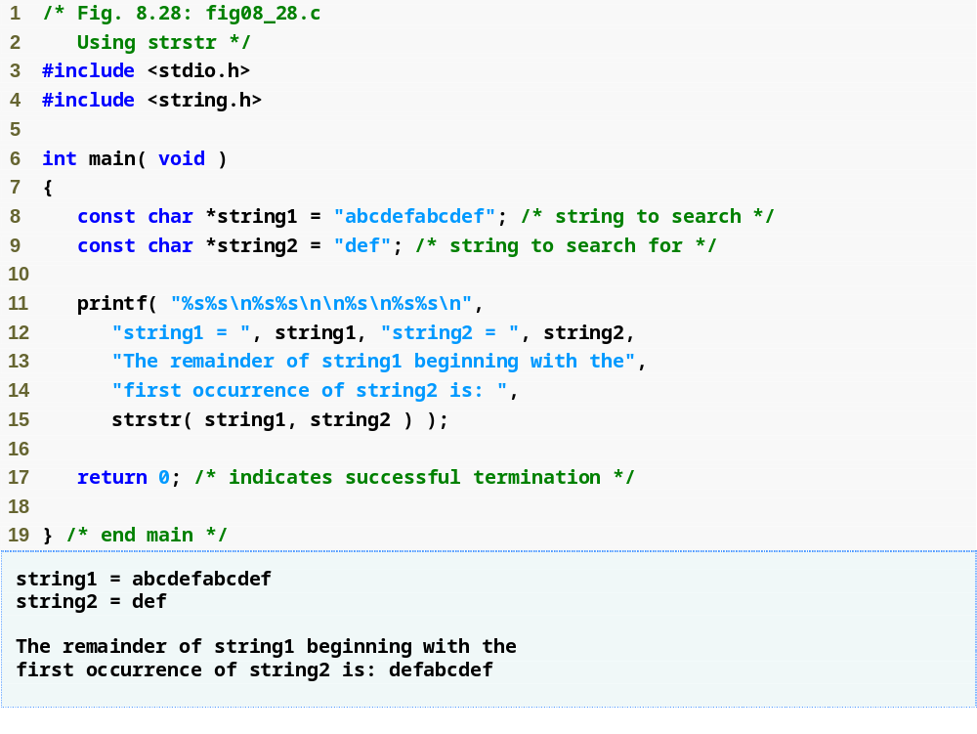
strstr returns the remainder of string1 following the first occurrence of string2
String1’in, string2’nin ilk geçtiği
yerden itibarenki kısmı

Slide 65
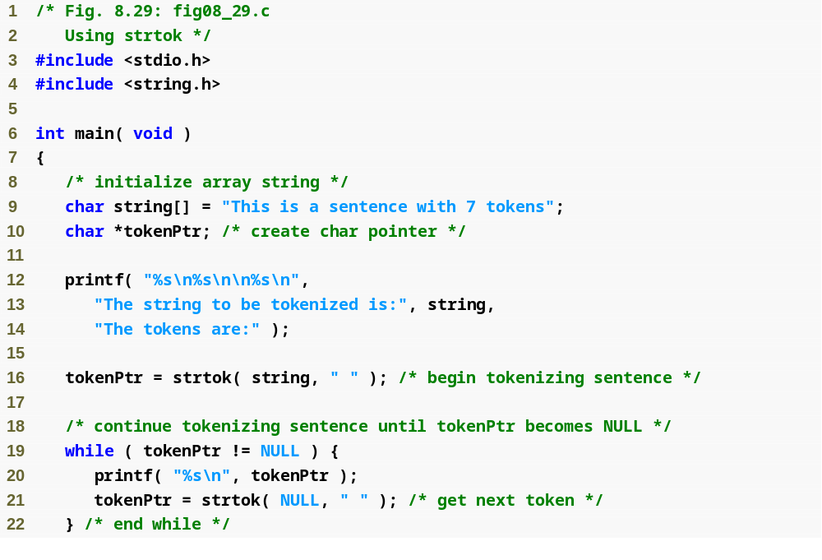
strtok “tokenizes” string by breaking it into tokens at each space
Calling strtok again and passing it NULL continues the tokenizing of the previous string

Slide 66
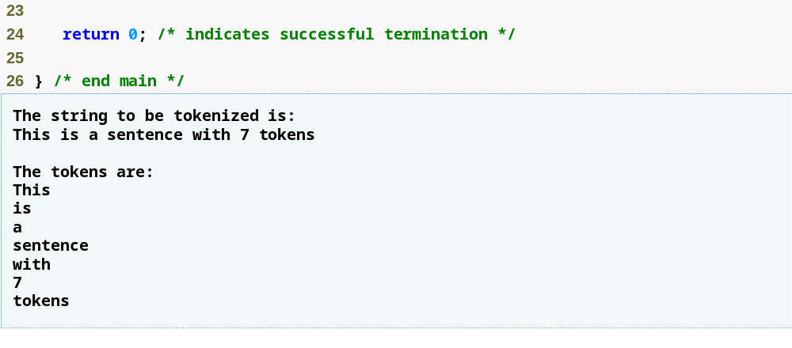

Slide 67
Memory Functions of the String-Handling Library
Memory Functions
  In <stdlib.h>
  Manipulate, compare, and search blocks of memory
  Can manipulate any block of data
Pointer parameters are void *
  Any pointer can be assigned to void *, and vice versa
  void * cannot be dereferenced
    Each function receives a size argument specifying the number of bytes (characters) to process

Slide 68
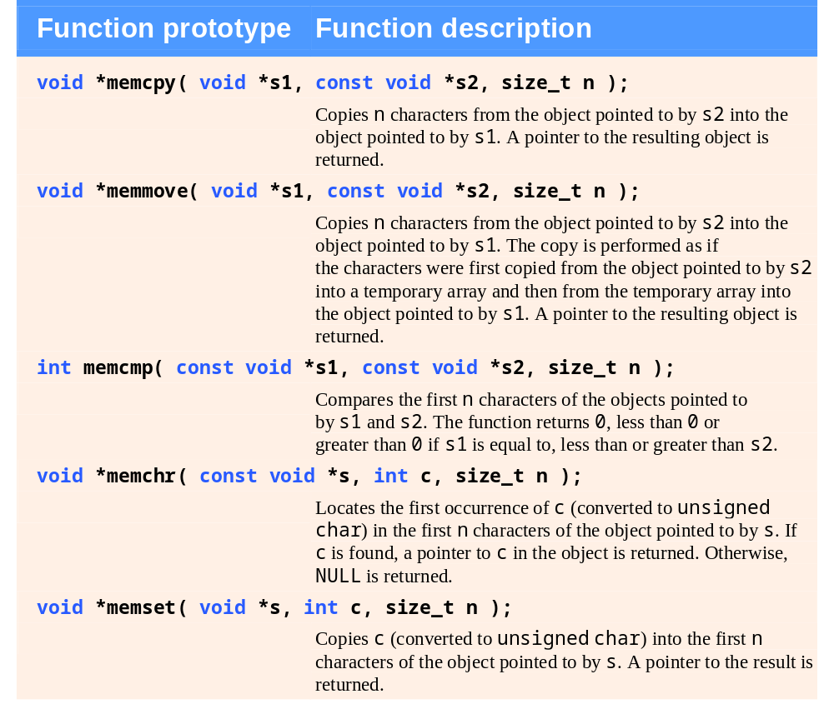
Memory functions of the string-handling library.

Slide 69
Common Programming Error 8.8
String-manipulation functions other than memmove that copy characters have undefined results when copying takes place between parts of the same string.

Slide 70
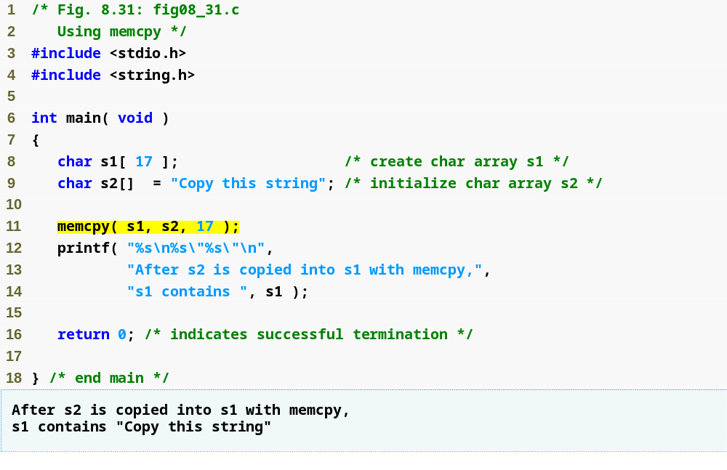
memcpy copies the first 17 characters from object s2 into object s1

Slide 71
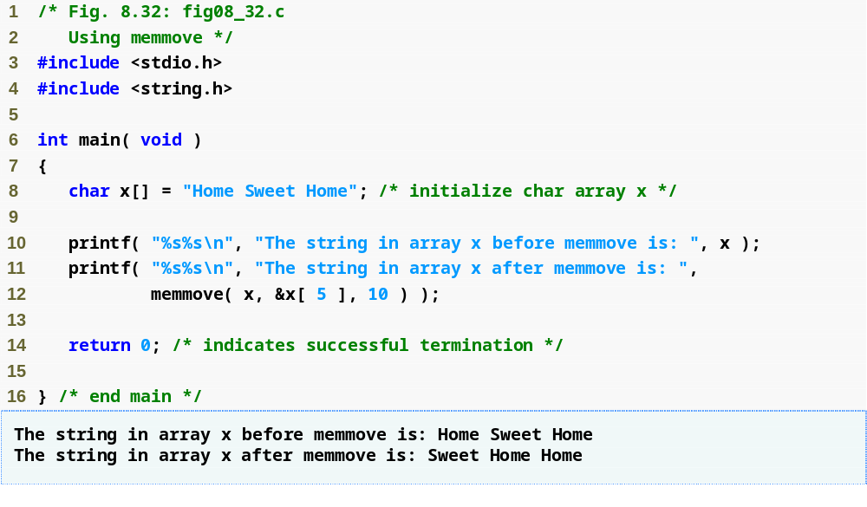
memmove copies the first 10 characters from x[5] into object x by means of a temporary array

Slide 72
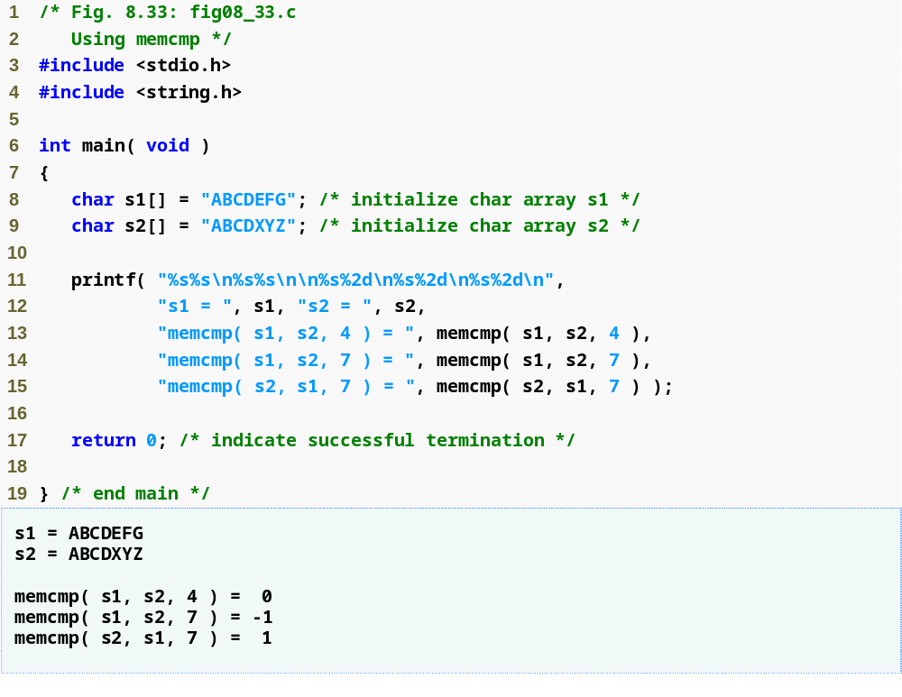
memcmp compares the first 4 characters of objects s1 and s2

Slide 73
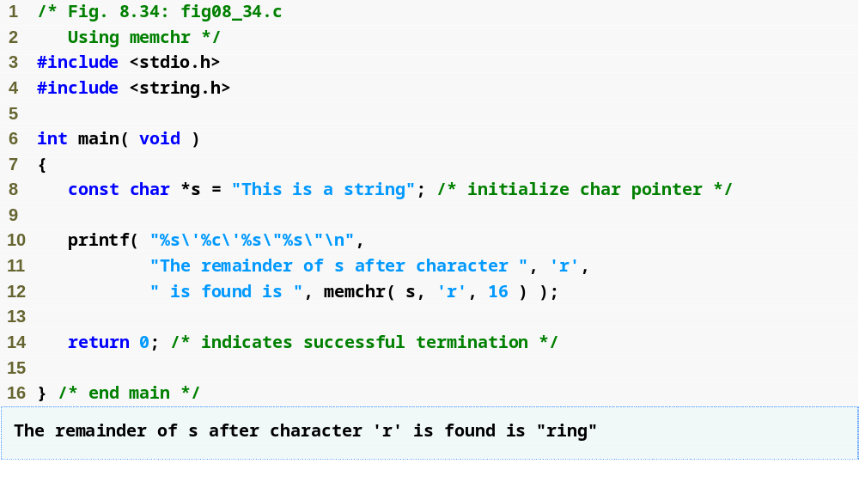
memchr locates the first occurrence of the character r inside the first 16 characters of object s

Slide 74
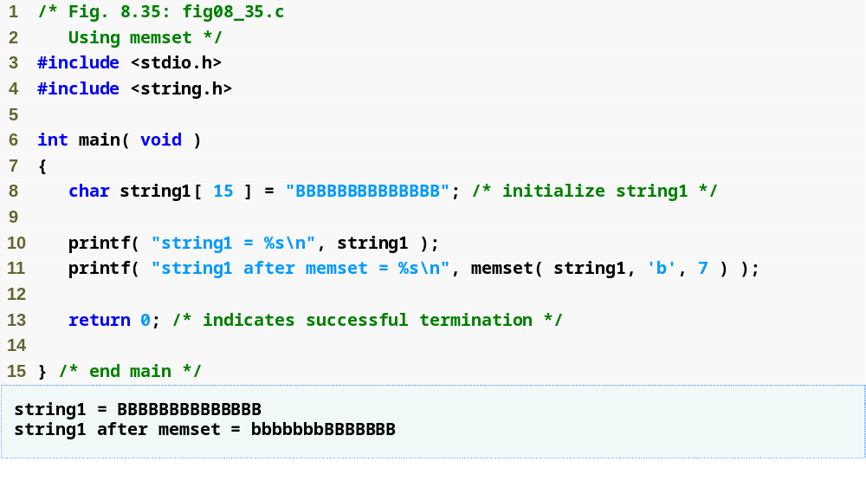
memset copies the character b into the first 7 characters of object string1

Slide 75
Referance
Ioannis A. Vetsikas, Lecture notes
Dale Roberts, Lecture notes

